Slide 1
Microprocessor Architecture ECE4375/5375
Dr. Argenis Bilbao
Spring 2026

Slide 2
Course Outline
What will you learn?
Computer architecture
  Memories
  I/O busses
  Multi processor systems
Microprocessor architecture
  Past CPU overview
  RISC/CISC
  Pipelines
  Caches

Slide 3
Expectations
Homeworks/Quizzes
NO EXAMS
Project-based grading
Projects mostly. Final 30% of grade.

Slide 4
Impact Areas
General-Purpose Laptop/Desktop
  Productivity, interactive graphics, video, audio
  Price-performance optimization
  Examples: Intel 386, Pentium, Core i7
Embedded Computers
  PDAs, cell-phones, sensors => Price, Energy efficiency, performance
  Examples: Intel XScale, StrongARM, Snapdragon, Helio
  Game Machines, Network uPs => Price-Performance
  Examples: Sony Emotion Engine (PS2), IBM 750FX (Game Cube), Cell (PS3)

Slide 5
Impact Areas
Commercial Servers
  Database, transaction processing, search engines
  Performance, Availability, Scalability, Power
  Server downtime could cost a brokerage company more than $6M/hour
  Examples: Sun Fire 15K, IBM p690, Google Cluster, AWS
Scientific Applications
  Protein Folding, Weather Modeling, CompBio, Defense
  Floating-point arithmetic, Huge Memories
  Examples: IBM DeepBlue, BlueGene, Cray, etc.

Slide 6
Software Trends
No longer just C and FORTRAN (Fortran still popular for numerical mathematics)
Object Oriented Programming (OOP)
Java / Python / Rust / R
Software now using hardware-based features to assist with security (TPM, AES, etc.)
Middleware
  Layer between app and hardware
  Used to minimize complexity

Slide 7
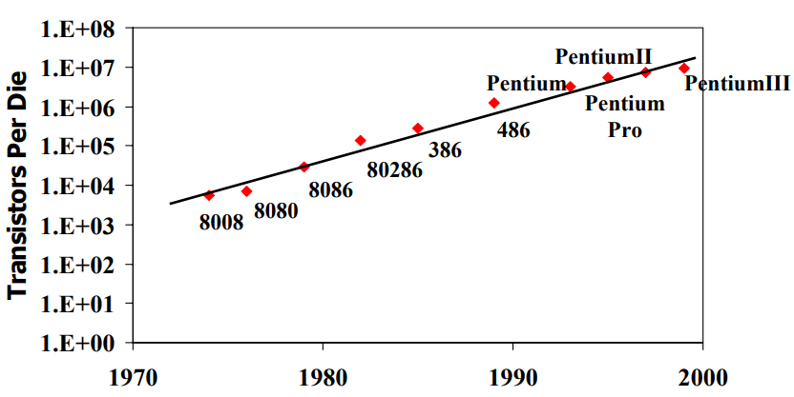
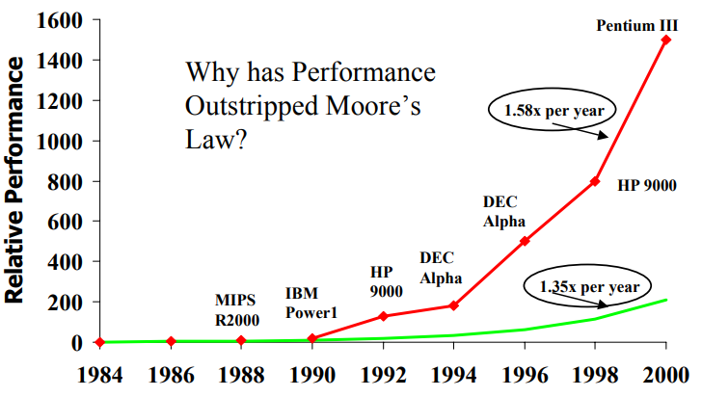
Moore’s Law
Every year
  Feature size decrease by 0.7x
  Number of transistors in a die increase by 2x
  Speed increases by 1.35x
We are reaching the physical limits!

Slide 8
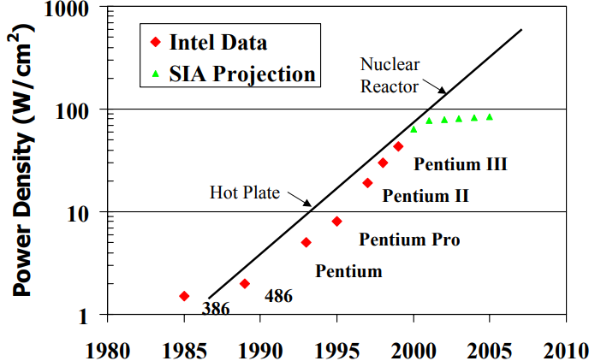
Moore’s Law
Architectural Innovations
  Massive pipelining (good and bad!)
  Huge caches
  Branch Prediction, Register Renaming, Speculation (hardware/software versions of all of these)
Circuit Innovations
  New logic circuit families (dynamic logic)
  Better CAD tools
  Advanced computer arithmetic

Slide 9
Dealing With Complexity
As an architect, our main job is to deal with tradeoffs
  Performance, Power, Die Size, Complexity, Applications Support, Functionality, Compatibility, Reliability, etc.
Technology trends, applications… How do we deal with all of this to make real tradeoffs?
Abstractions allow this to happen
Focus is on metrics of these abstractions
  Performance, Cost, Availability, Power

Slide 10
Metrics: Performance
Reduce Response/Execution Time
  Time between start and completion of an event
Increase Throughput
  Total amount of work in a given amount of time
Execution Time is reciprocal of performance
“X is N times faster than Y”
N=Execution TimeY/Execution TimeX
Wall-Clock Time, CPU time (no I/O)

Slide 11
Metrics: Performance
Execution Time is often what we target
Throughput (tasks/sec) vs. latency (sec/task)
How do we test systems? Benchmarks (best to worse)
  What the customer cares about, real applications
  Representative programs (SPEC, SYSMARK, etc.)
  Kernels: Code fragments from real programs (Linpack)
  Toy Programs: Sieve, Quicksort
  Synthetic Programs: Just a representative instruction mix (Whetsone, Dhrystone)

Slide 12
Metrics: Performance (MIPS)
MIPS = instruction count/(execution time x 10⁶)
Problems
  ISAs are not equivalent, e.g. RISC vs. CISC
    1 CISC instruction may equal many RISC!
  Programs use different instruction mixes
  May be ok when comparing same benchmarks, same ISA, same compiler, same OS

Slide 13
Metrics: Performance (MFLOPs)
Same as MIPS, just floating-point operations
Not useful either
  FP-intensive apps needed
  Traditionally, FP ops were slow, INT can be ignored
  However, now memory ops can be the slowest!
“Peak MFLOPs” is a common marketing fallacy
  Basically, it just says #FP-pipes X Clock Rate

Slide 14
Metrics: Performance (GHz)
Is this a metric? Maybe as good as the others…
One number, no benchmarks, what can be better?
Many designs are frequency driven

Slide 15
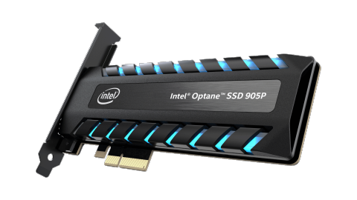
Metrics: Availability
Availability: Fraction of Time a system is available
For servers, may be as important as performance
Mean Time Between Failures (MTBF)
  Period that a system is usable (on average)
  Typically, 500,000 hours for a PC Hard drive, much worse for SSDs
Mean Time to Repair (MTRR)
  Recovery time from a failure
  Should approach 0 for a big server (redundancy)

Slide 16
Metrics: Power
We all understand why energy is important for embedded CPUs…
High-end Server: ~130-470W
High-end Desktop: ~70-170W
High-end Laptop: ~60W
Battery-Optimized Laptop: ~3-10W
Embedded CPUs: ~.5-8W
DSP: ~100mW
Microcontrollers: ~10mW

Slide 17
Sources
http://www.eecs.harvard.edu/cs146-246/
Assigned Textbook
Wikipedia
https://www.google.com/

